Slide 1

Notes:
Updates to this page will be made by Tyler only, the order of the presentations should remain the same as well.
For any major alteration requests or additions to the presentation - contact Tyler at tylerhiggs@langara.ca

Slide 2

WMDD Capstone 2026
Event Program
5:30 - 6:00 - Arrival and networking
6:00 - 6:15 - Start! Intro to WMDD overview & video
6:15 - 6:30 - Feedback panelist introductions
6:30 - 8:30 - Student Project presentations
8:30 - 8:40 - Show results
8:45 - End - Final announcements and close
Notes:
Updates to this page will be made by Tyler only.

Slide 3


Langara College would like to acknowledge that it is located and that today we are gathered on the traditional, ancestral and unceded territory of the Coast Salish peoples – Sḵwx̱wú7mesh (Squamish), Stó:lō and Səl̓ílwətaʔ/Selilwitulh (Tsleil-Waututh) and xʷməθkʷəy̓əm (Musqueam) Nations.
Notes:
Updates to this page will be made by Tyler only.

Slide 4

The Web and Mobile App Design and Development is a two-year post-baccalaureate diploma program that focuses on web and mobile app design and development, from concept to deployment.
www.langara.ca and langara-app.ca
David Wright
Spencer Dane
Jason Madar
Dean of Arts
Faculty of Arts
Division Chair
Creative Arts & Industry
Coordinator
WMDD
Notes:
Updates to this page will be made by Tyler only.
Langara College is one of BC's leading undergraduate institutions providing University Studies, Career Studies, and Continuing Studies programs and courses to more than 21,000 students annually.

Slide 5
WMDD Faculty
Part of what distinguishes the Langara WMDD Program is our industry-driven instructors and instructional assistants. Highly qualified in their respective fields, they bring industry knowledge, work-ethic, and practical experience to the classroom.
Jason Madar
Jacob Tran
Tyler Higgs
Peter Vysek
Reza Abbasi
Lu Yu
Jessica Ortega
Josue Menjivar
Paul Brassard
Reza Etemadi
Jordan Miller
Tito Ferradans
Jorge Puertovannetti
Kevin McMillan
Richard Wong
Tomoko Okochi
Ivan Wong
Binazir Farokhi
Valentina Abanina
Sebastian Richardson
Amandeep Singh
Notes:
Updates to this page will be made by Tyler only.

Slide 6

Fasken is British Columbia’s largest law firm, with over 165 lawyers offering deep experience in business law and litigation services. From our Vancouver office, we provide clients—both local and international—with strategic legal advice across a broad range of industries.
With more than 135 years in the province, we have a long-standing presence in the local business community through our commitment to a variety of causes. As the official law firm of the Vancouver Canucks, we are proud to support initiatives that strengthen our community and reflect our mission, vision and values.
https://www.fasken.com/
Notes:
Updates to this page will be made by Tyler only.

Slide 7

UBC Robson Square
Our Facility - is the heart of the Robson Square complex – a site in downtown Vancouver designed by internationally renowned architect Arthur Erickson. This civic complex is home to the Law Courts, government offices and the Vancouver Art Gallery. Robson Square is at the epicentre of Vancouver’s social, cultural and business districts.
Our Partners - UBC Robson Square is proud to partner with UBC Extended Learning, UBC Sauder School of Business, and the Office of the Vice-President, Research & Innovation.
https://robsonsquare.ubc.ca/
Notes:
Updates to this page will be made by Tyler only.

Slide 8


Capstone Project
Final Term - Functional Mobile MVP
with Web & Marketing Materials
WMDD - 2026
Notes:
Updates to this page will be made by Tyler only.

Slide 9
WMDD Capstone Project
The Capstone Project is the final and most demanding project for all the students in the Langara Web and Mobile Design & Development program. These multi-platform software projects require a functional MVP with set design and development features to be completed by the end of their term.
Complete documentation of project research, market/competitive analysis, AI integration & analysis, business case study, agile development planning, UX/UI design, and web/marketing materials are just some of the deliverables for these teams.
Notes:
Updates to this page will be made by Tyler only.

Slide 10
Concept to code-driven mobile MVP.
13
Weeks
Students form their own teams and come up with their own ideas based on the platform and constraints of the course.
Market research and competitive analysis
UX design from IA to high-fidelity wireframes
System architecture, security, data-model, and AI
Weekly reports, and project documentation
10 weeks of development time (with other class work)
Bug testing, alpha/beta build demo, and QA
Promotional materials and website
Notes:
Updates to this page will be made by Tyler only.

Slide 11
Industry driven schedule + deliverables
10
Term Courses
260+
Lab Hours
530+
Non-lab Hours
-
Students
-
Capstone
Projects
As in industry, there is always so more time and effort put into projects like these. What we see today is only a small sample of the total planning, research, writing, UI/UX design, frontend/backend development, testing and demo preparation.
Only one day a week do students have a class together, as a team.
Notes:
Updates to this page will be made by Tyler only.

Slide 12
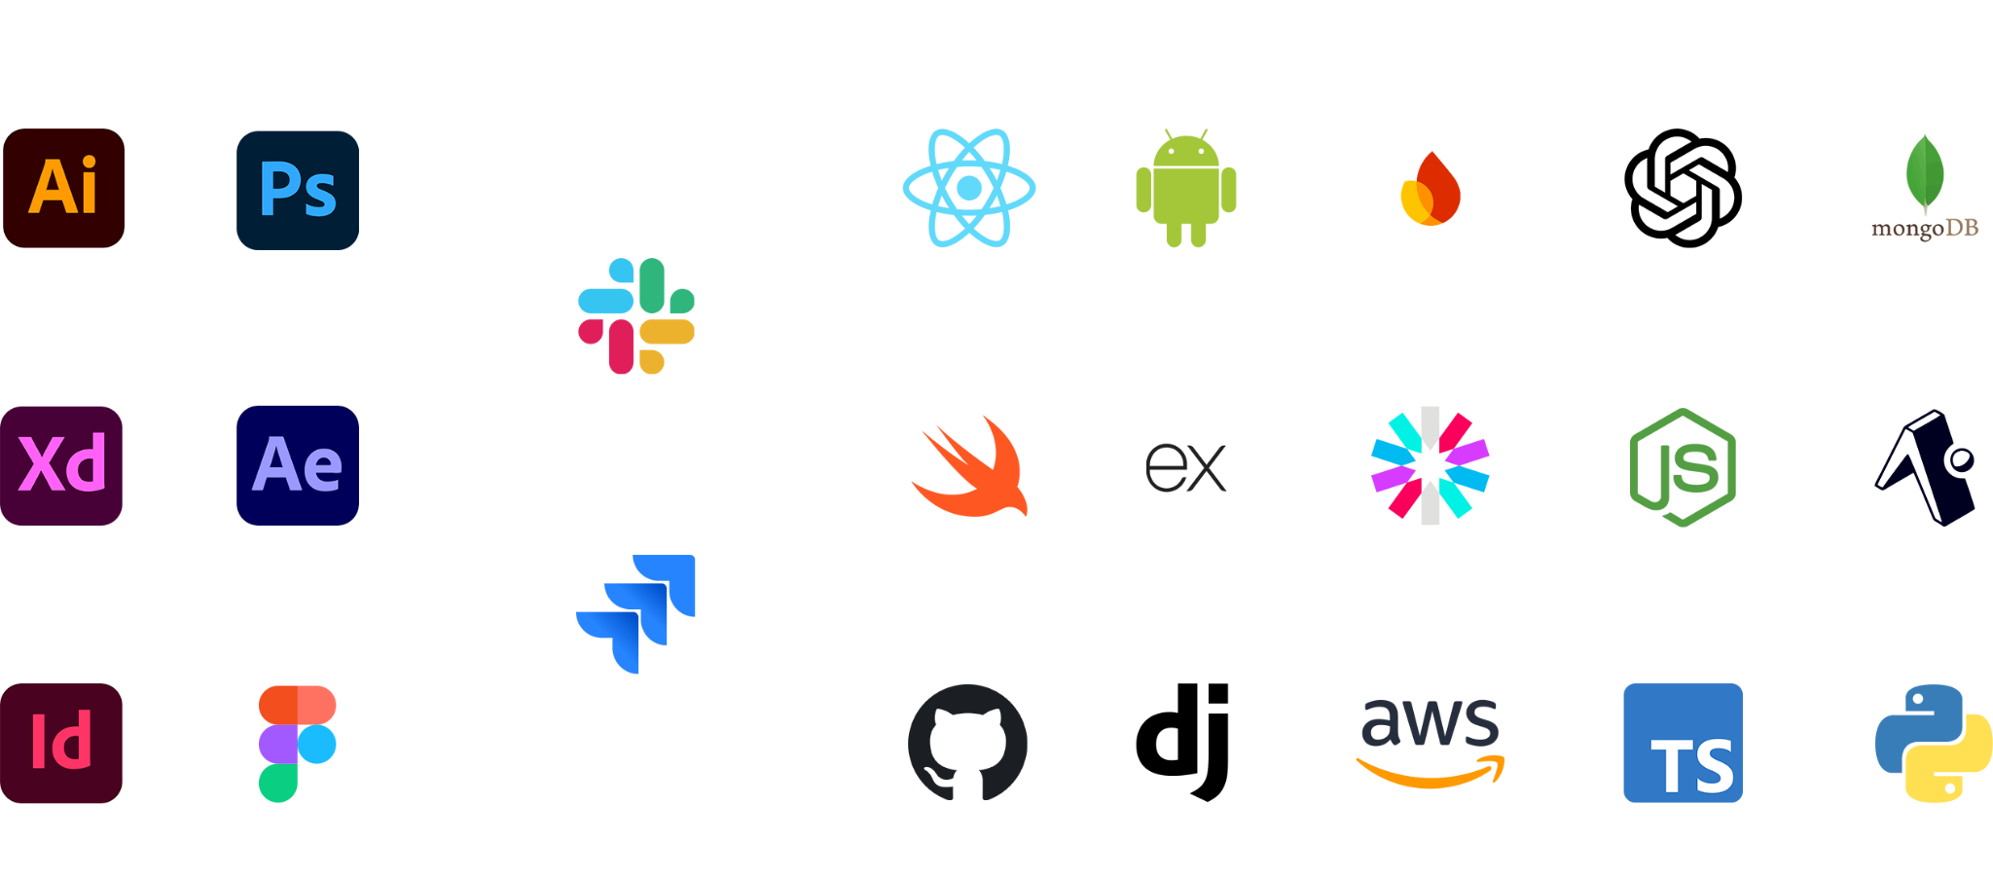
Design & Development Focus
The WMDD programs focus is in the latest development tools and design practices, but also in developing communication and teamwork skills sought after in industry.
Notes:
Updates to this page will be made by Tyler only.

Slide 13


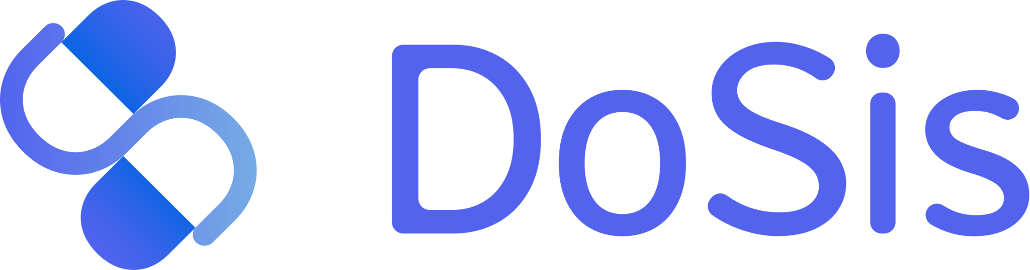

Tonight’s Projects
https://zyra.wmddprogram.com/
https://inspecproperty.vercel.app/
https://dosis-wmdd.netlify.app/
https://pip-wmdd.vercel.app
Notes:
Updates to this page will be made by Tyler only.

Slide 14
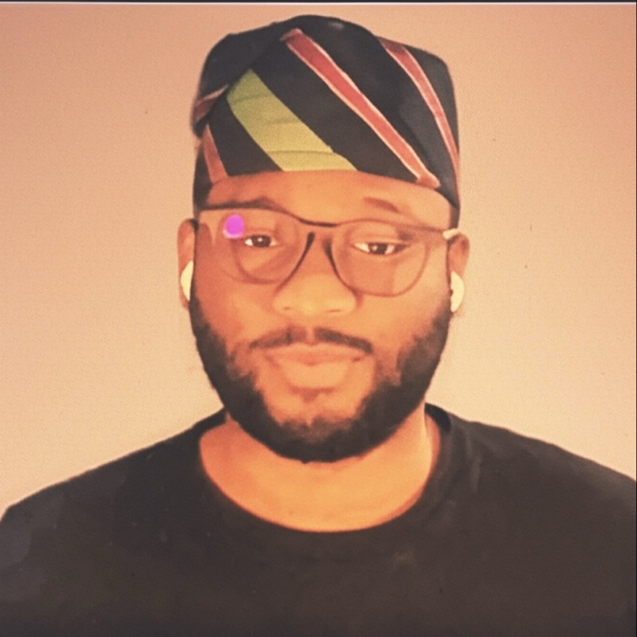

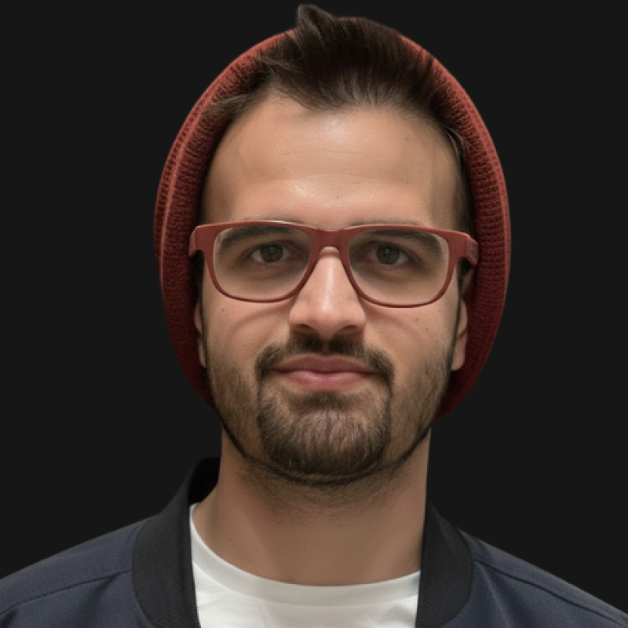
Tonight’s Feedback Panelists
Favour Chukwuedo
Megan (Lynch) Drummond
Pooria A.
CTO I EdTech Innovator
PurePay
Senior Designer & Creative Director
Toolbox Design
Managing Partner
Beeloud

Slide 15
Onto the project presentations!
Please put your phone on silent for the duration of presentations.
Notes:
Updates to this page will be made by Tyler only.

Slide 16
Zyra is a mobile app for children that brings good habits to life with Augmented Reality (AR). When users complete tasks, they unlock surprises—like flowers or dinosaurs—that appear as interactive AR objects. Kids also discover fun facts about each object, making the process both educational and entertaining.
https://zyra.wmddprogram.com/
InSpec provides property owners, landlords, and tenants with a comprehensive tool to inspect, analyze, and document a location's state before and after the rental period, offering users transparency in the property's condition. InSpec utilizes AI enhancement to detect and highlight damages.
https://inspecproperty.vercel.app/
DoSis manages and tracks ingestibles, such as medications, supplements, and over-the-counter pharmaceuticals. It helps to prevent missed doses, unsafe combinations, and confusion by integrating schedules, providing explanations, risk alerts, and fitting into routines.
https://dosis-wmdd.netlify.app/
PIP is a mental wellness and communication app that helps users manage mild to moderate social anxiety through AI-driven scenario practice. It offers a non-judgmental space to build social confidence through its comprehensive AI-powered feedback. Training is delivered through a progressive system with increasing difficulty, encouraging engagement with personalized growth.
https://pip-wmdd.vercel.app/
Notes:
Updates to this page will be made by Tyler only.

Slide 17
Thank You!
We hope you enjoyed the
WMDD Capstone Presentations.
Please feel free to network, ask questions, check out each project and connect with our ready-to-work graduates!
https://langara-app.ca/
Notes:
Updates to this page will be made by Tyler only.

